Slide 1
Multi Document Summarization with K-Means Clustering Algorithm
done by SivaPrasad (P181308),
under the guidance of Dr.A.Martin,
ASSOCIATE PROFESSOR,
Dept. Of Computer Science, CUTN.

Slide 2
Need for Multi Document Summarization :
Textual Information is increasing day by day. Manual reading is necessary to understand documents.
For the large set of information, containing more documents it is not easy or efficient to go by reading all.
So, multi document Summarization will be helpful for quickly understand the the overall content of the large information.
The results are better, sometimes, by applying few Algorithm on the processed textual data.
And Text Summarization is one of the Research area regarding AI.

Slide 3
My approach to solve the problem :
The program may collect the data from Google Search regarding the topic(Searched Keyword).
The collection of documents are made into collection of Sentences by splitting them to the end of each sentence.
By using Kmeans clustering algorithm I will make all the sentences into separate groups so that all the sentences that give similar meaning may be clustered into one single cluster.
Then from all the available clusters I will pick one sentence from each cluster and join them to form the summary.

Slide 4
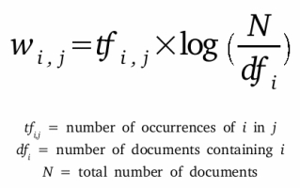
Processing the data to feed into Kmeans algorithm :
The documents need to be split into sentences.
Calculate numerical values to sentences based on their frequency.
Compared to word frequency(ratio of occurrence of word to no of words), Tf-Idf(product of word frequency and Inverse document frequency[ratio of number of documents to no of documents the word contained in]).
Formally,
Some data cleaning may be need for each of the above steps.

Slide 5
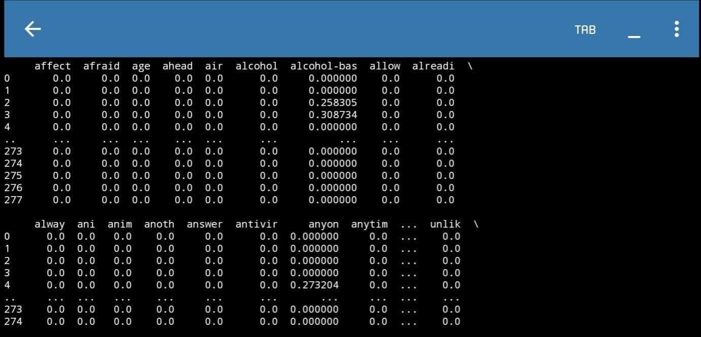
TfIdf matrix :

Slide 6
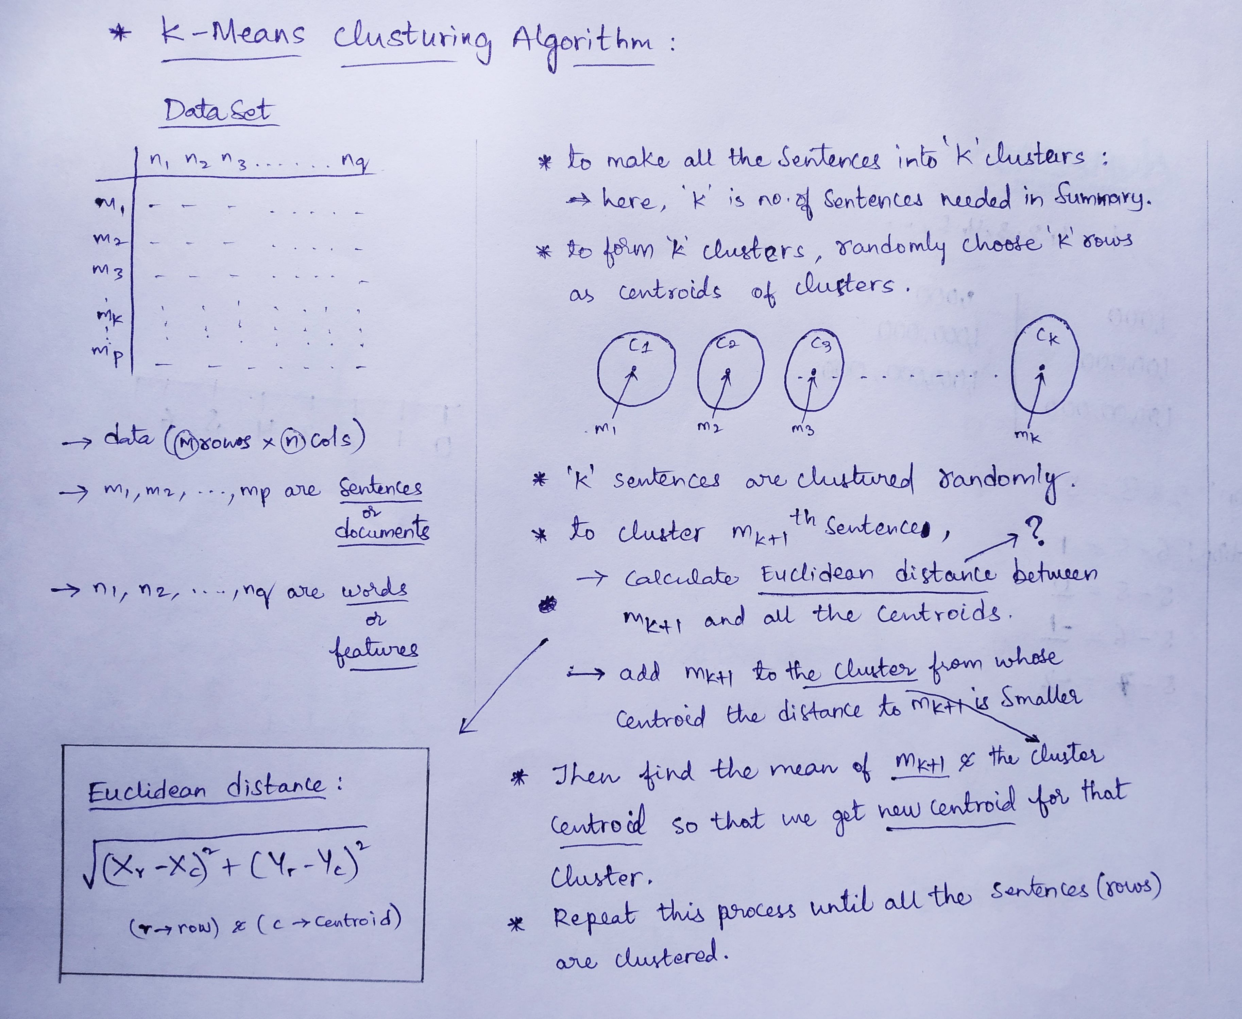
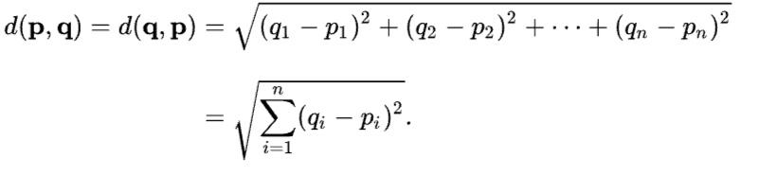
Working of Kmeans Algorithm :

Slide 7
Implementing K-means using SciKitLearn :
SciKit Learn is a good library for Machine Learning implementation.
I have used TfIdfVectorizer to compute TfIdf values for each Sentence.
I have used KMeans library to cluster the sentences.
I have used PCA(Principal Component Analysis) to reduce the columns of the dataset, for the need to plot the graph.

Slide 8
Visualizing the Results :
To visualize, we’ll plot the features in a 2D space. As we know the dimension of features that we obtained from TfIdfVectorizer is quite large, we need to reduce the dimension before we can plot. For this, we’ll ues PCA to transform our high dimensional features into 2 dimensions.
Then using matplotlib we can draw scatter plot to visualise the results.
All the observations are represented as dots and
The selected rows for summary are marked as ‘x‘.

Slide 9
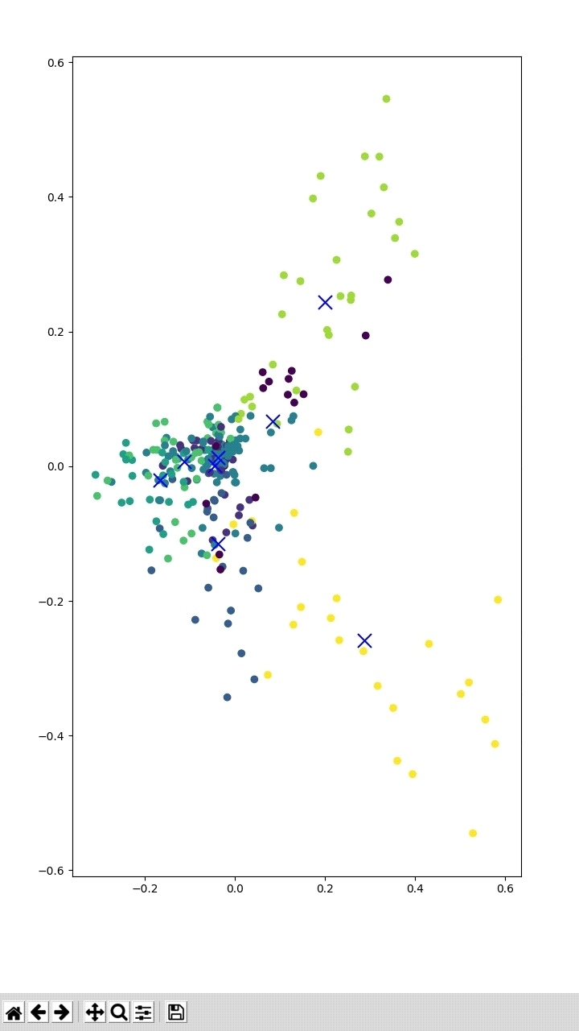
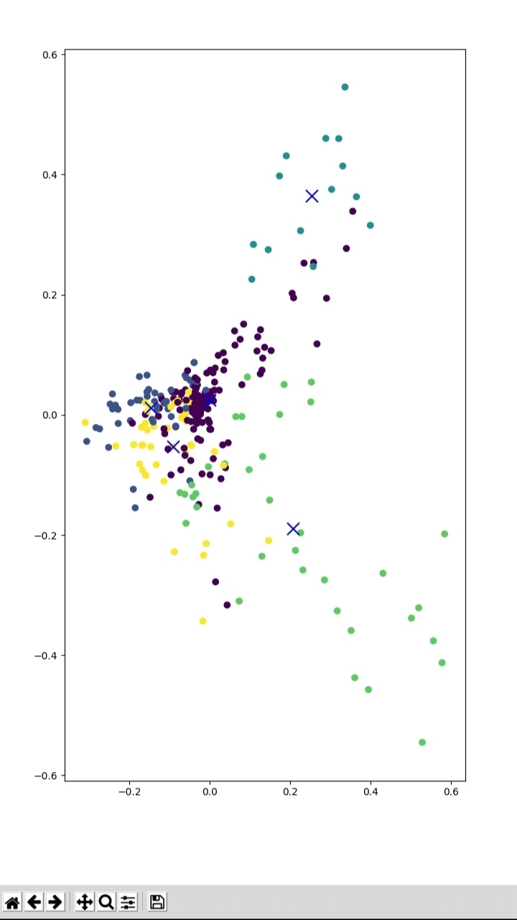
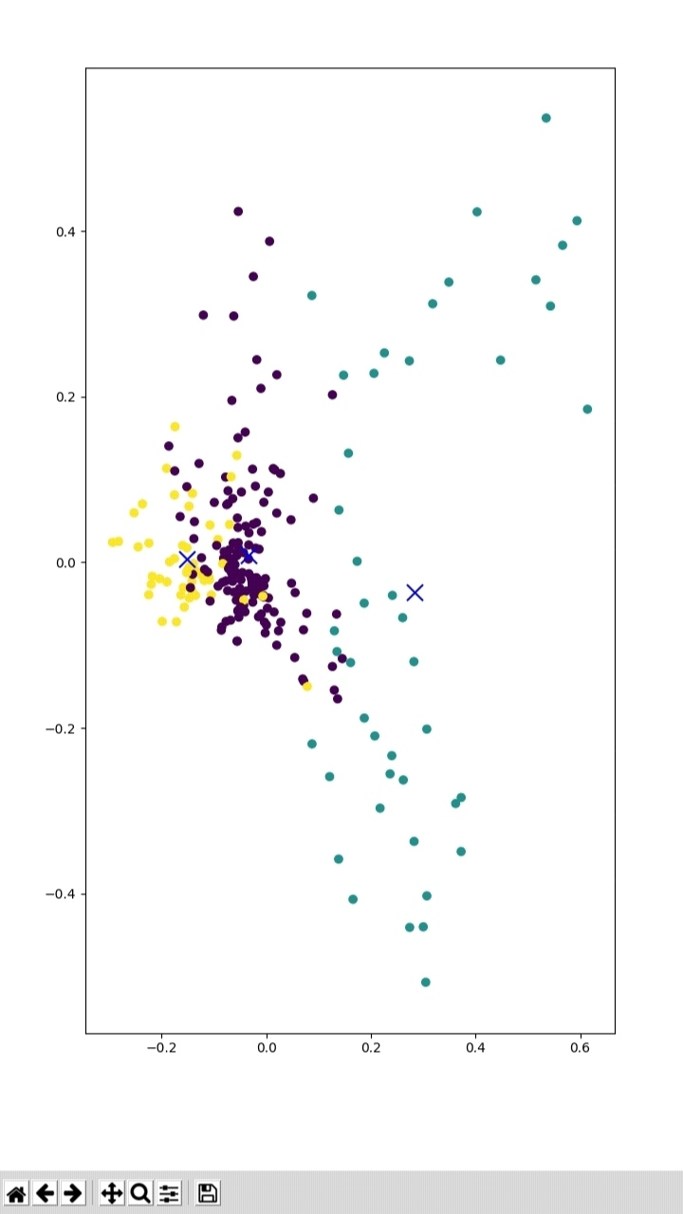
Visualizing the results :
8 Clusters
5 Clusters
3 Clusters

Slide 10
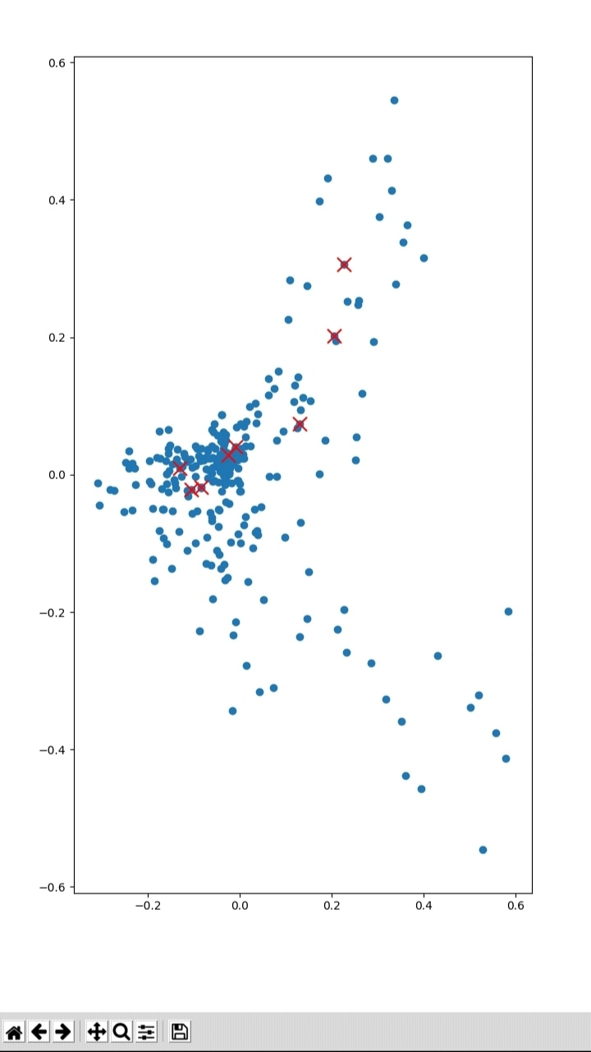
Comparison with Old Probabilistic Summarization: (TfIdf) Vs (TfIdf+KMeans) :
TfIdf Summary points
KMeans Clusters Centroids

Slide 11
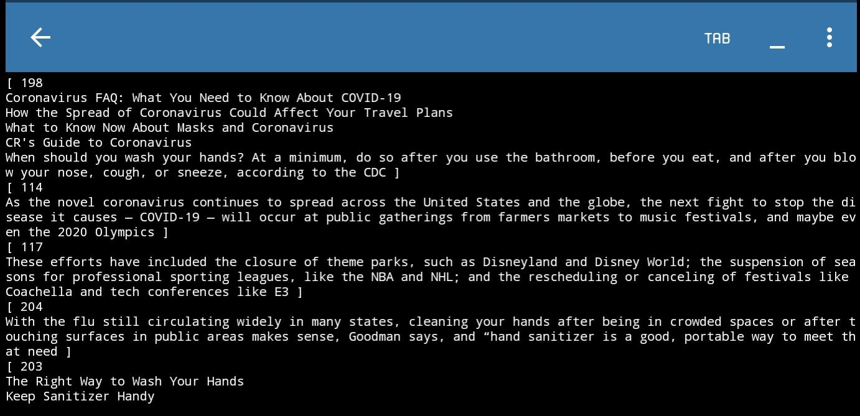
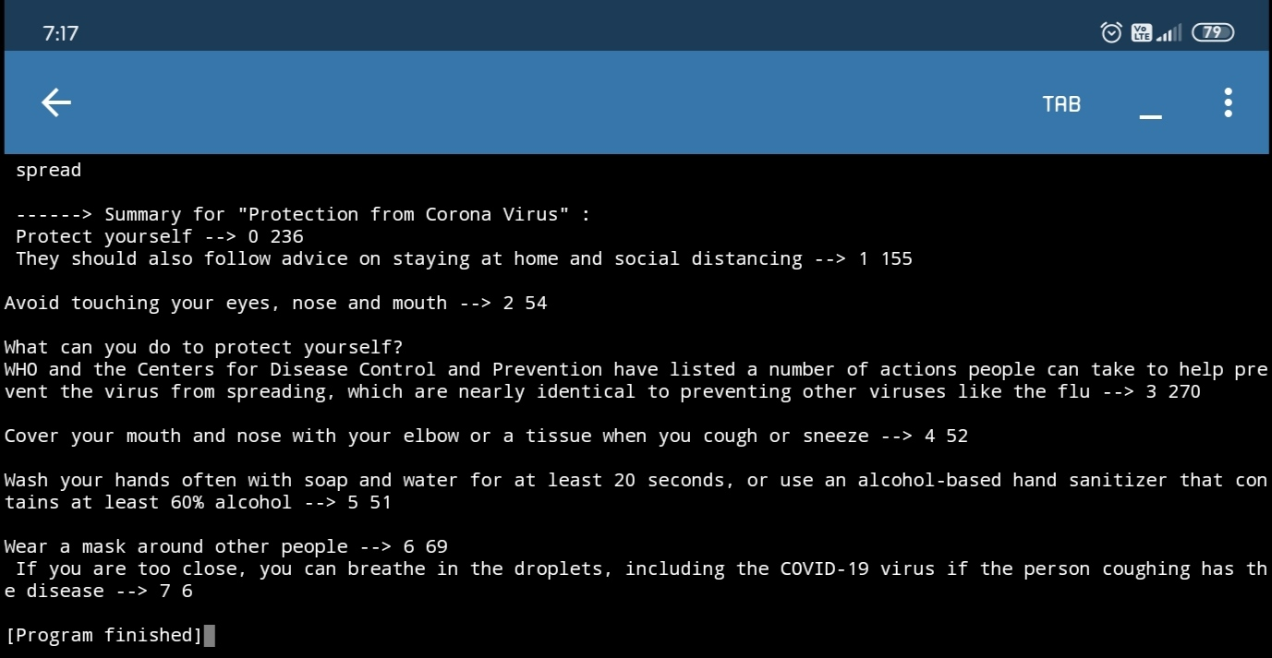
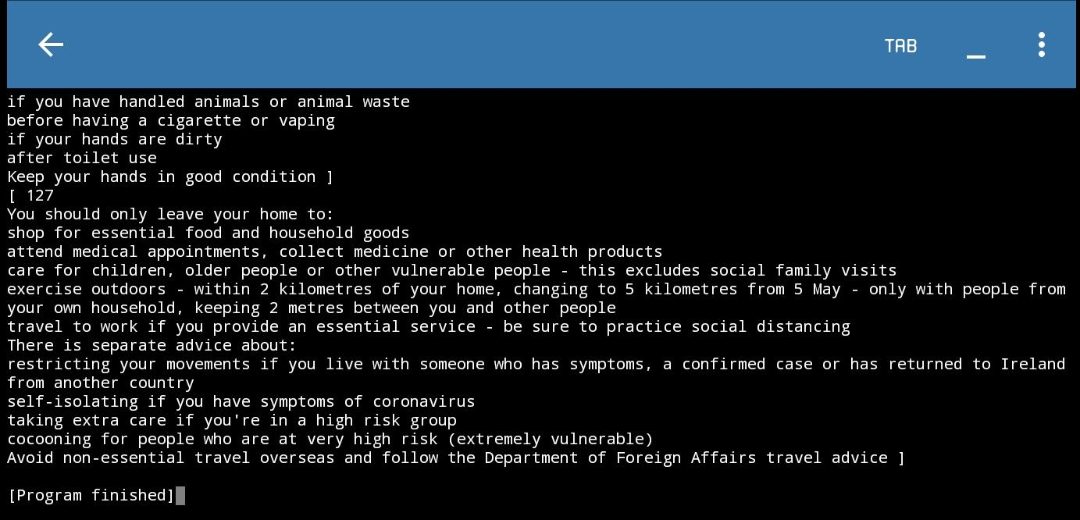
Comparing Summaries :
TfIdf Summary :
KMeans Summary :
TfIdf Summary (cont.)

Slide 12
Conclusion & Future work :
I feel the results with K-means clustering on document Summarization are better compared to Summarising with word frequency counting. Because each sentence in the summary is selected from different clusters.
Still this not desired, we can use neural networks to improve the results in extractive text Summarization.
And improving Algorithms of Abstractive text Summarization will give better results because some what meaningful summary generation could be expected.
And data cleaning, feature selection are also important research areas which helps in forming meaningful summary.

Slide 13
ThankYou..

